Slide 1
Why New Labour Codes?

Slide 2
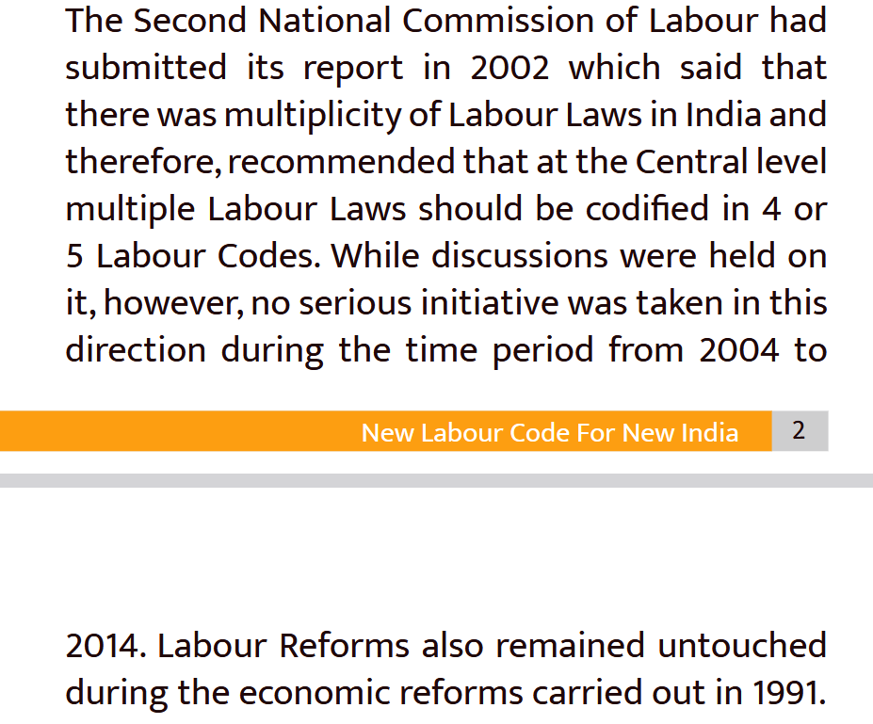
Why Labour Codes

Slide 3
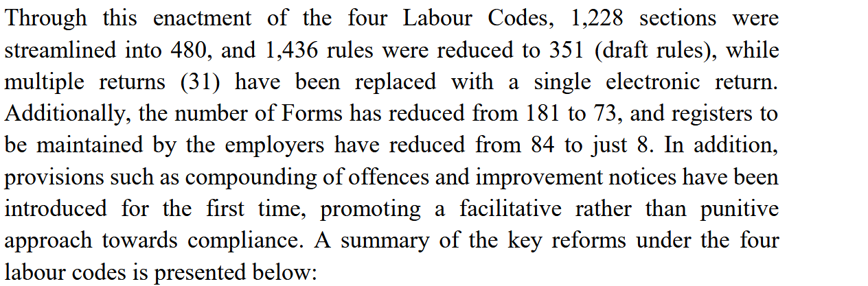
Simplification

Slide 4
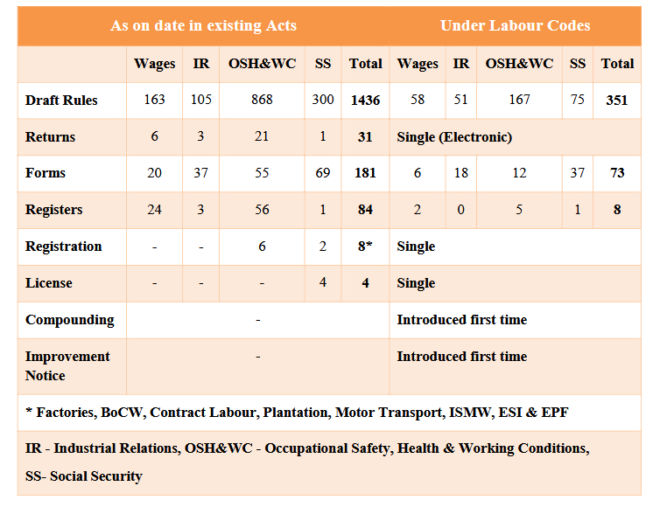
Comparison

Slide 5
The Journey of the Code on Social Security..
Date of initial introduction in Parliament- 11.12.2019(Bill no 375 of 2019)
Date of reintroduction in the Parliament- 19.09.2020 (Saturday) (Bill no 121 of 2020)
Passed by the Lok Sabha- 22.09.2020 (Tuesday)
Passed by the Rajya Sabha- 23.09.2020 (Wednesday)
Presidential assent received- 28.09.2020 (Monday)
Code Provisions Notified in the Gazette- 29.09.2020 (Tuesday) (Act 36 of 2020)
Date of implementation of Code- 21.11.2025
Draft SS Code (Central) Rules notified-
First time- 13.11.2020
Second time- 03.06.2021
Third time- 30.12.2025
Final SS Central Rules Published-08.05.2026

Slide 6
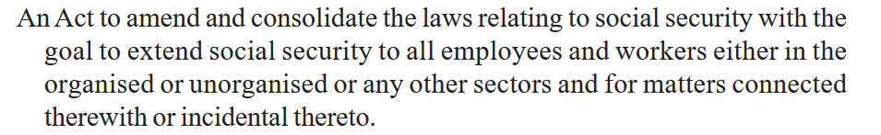
Difference in Preamble
ESI Act, 1948
Code on Social Security,2020

Slide 7
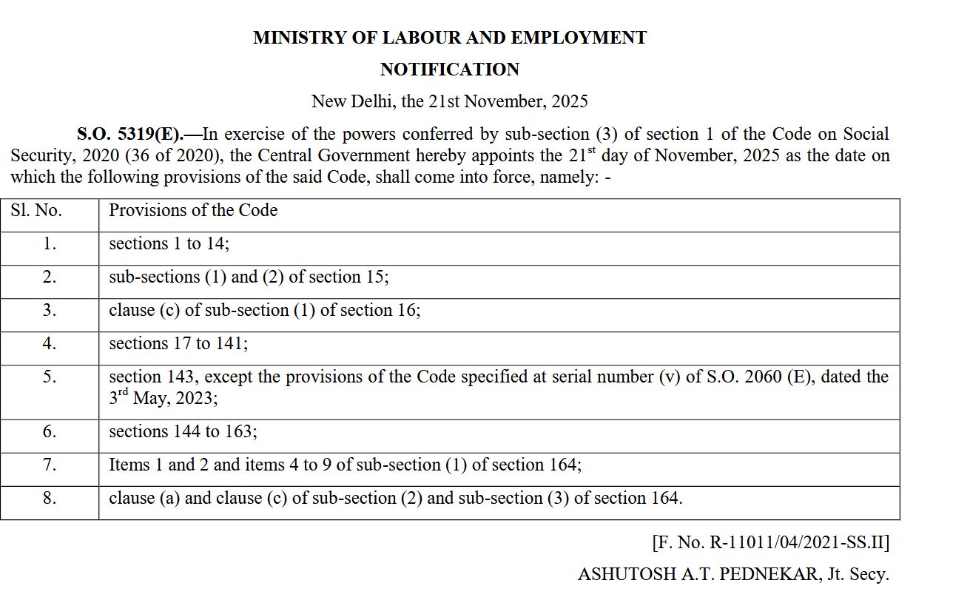
Notification-Code on Social Security, 2020

Slide 8
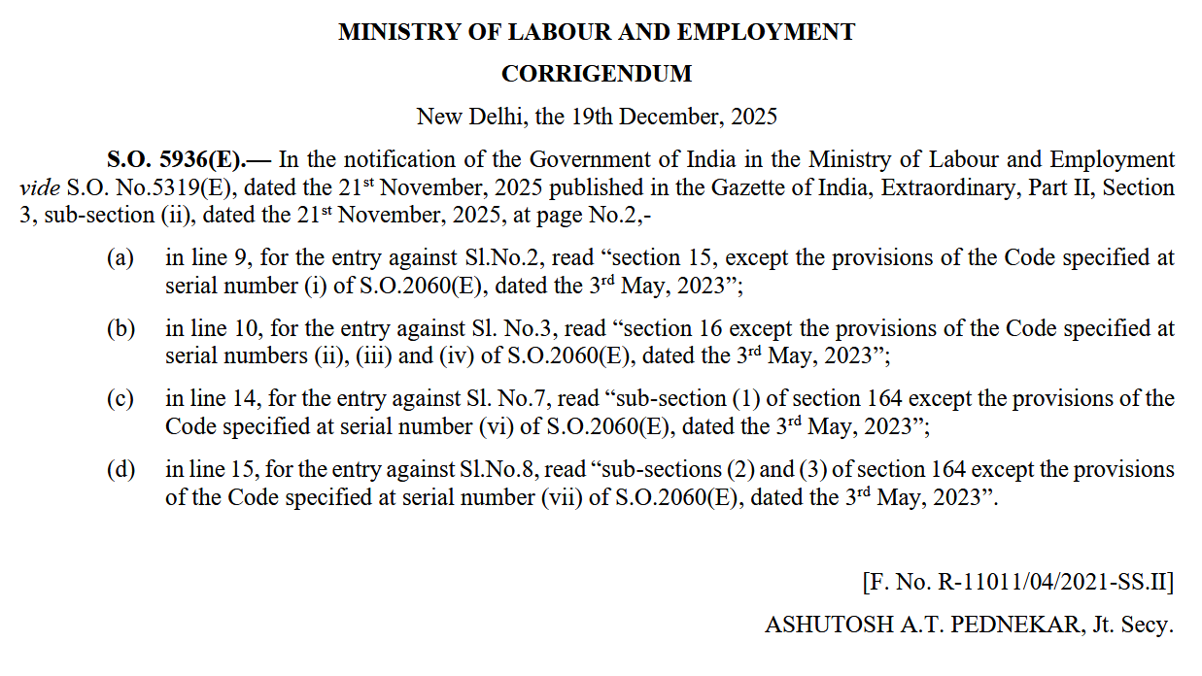
Notification-Code on Social Security, 2020

Slide 9
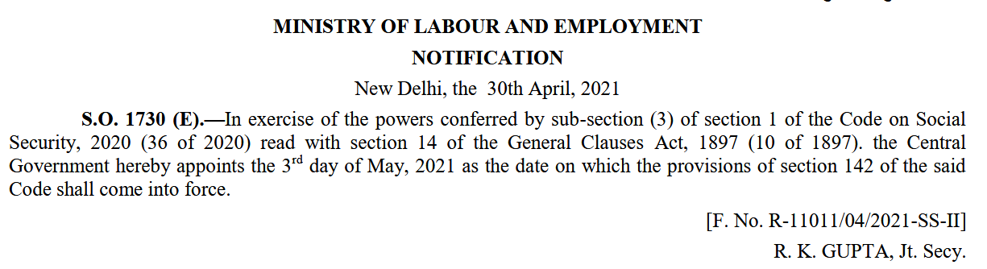
Notification u/s 142

Slide 10
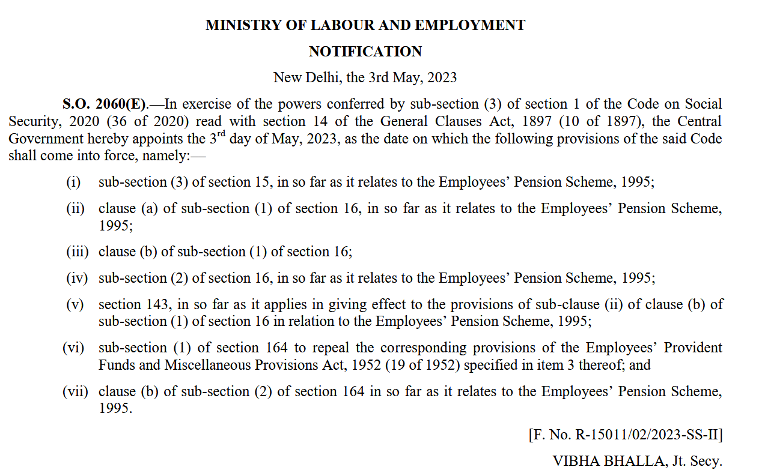
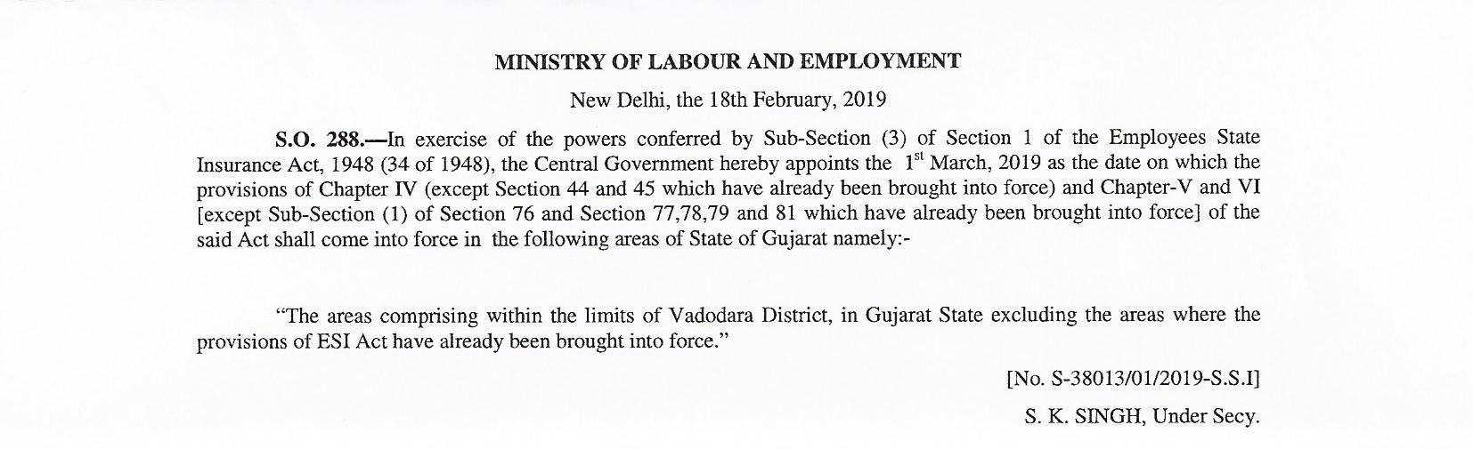
Notification relating to EPFO under CoSS

Slide 11
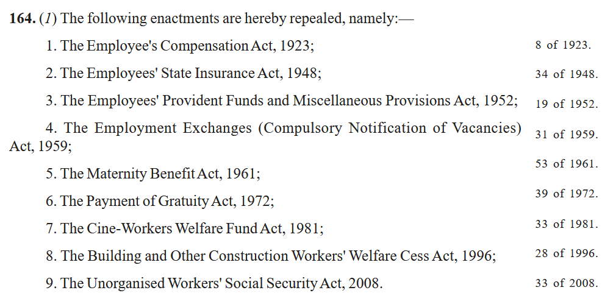
Section 164(1) of CoSS 2020

Slide 12
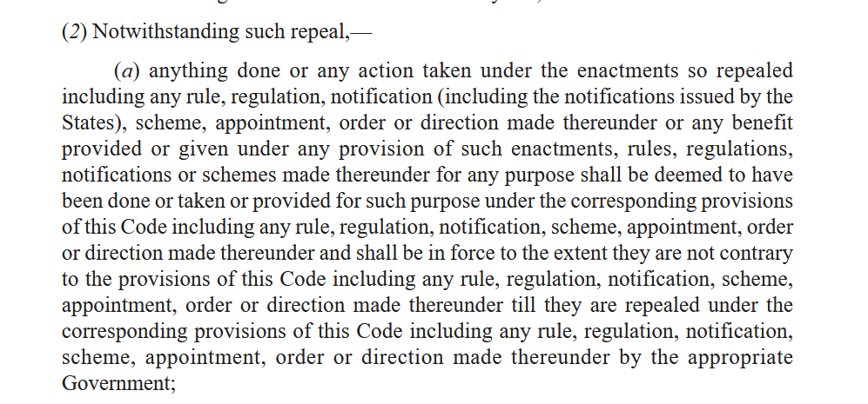
Section 164(2)(a) of CoSS 2020

Slide 13
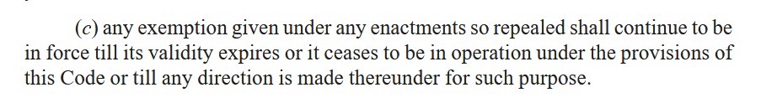
Section 164(2)(c) of CoSS 2020

Slide 14
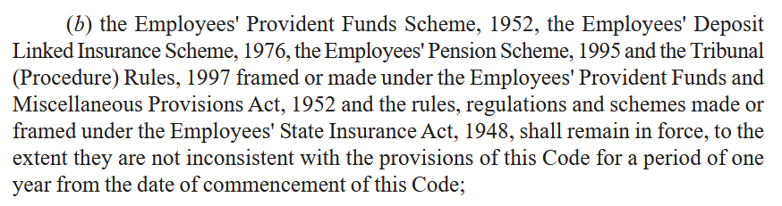
Section 164(2)(b) of CoSS 2020

Slide 15
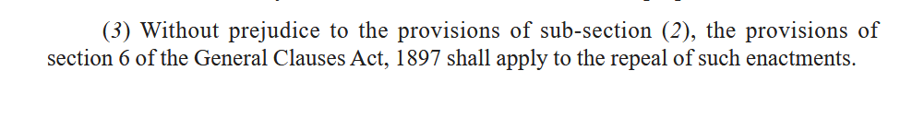
Section 164(3) of CoSS 2020

Slide 16
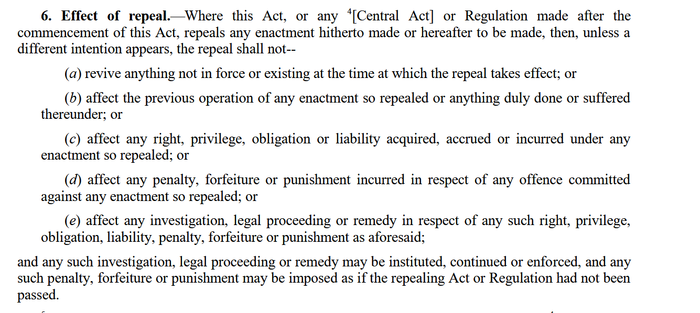
Section 6 of General Clauses Act 1897

Slide 17
ESI under the Code on Social Security, 2020
The Employees' State Insurance Act, 1948 has been subsumed alongwith 8 other Acts in the Social Security Code, 2020 (Act 36 of 2020).
The other Acts subsumed in the Code on Social Security are:-
The Employees’ Compensation Act, 1923;
The Employees’ Provident Funds and Miscellaneous Provisions Act, 1952;
The Employment Exchanges (Compulsory Notification of Vacancies) Act, 1959;
The Maternity Benefit Act, 1961;
The Payment of Gratuity Act, 1972;
The Cine-Workers Welfare Fund Act, 1981;
The Building and Other Construction Workers' Welfare Cess Act, 1996;
The Unorganised Workers' Social Security Act, 2008

Slide 18
Code on Social Security, 2020
Sl. No. | Chapter no. | Chapter Heading | Sections
1 | I | Preliminary | 1-3
2 | II | Social Security Organisations | 4-13
3 | III | Employees Provident Fund | 14-23
4 | IV | Employees State Insurance Corporation | 24-52
5 | V | Gratuity | 53-58
6 | VI | Maternity Benefit | 59-72
7 | VII | Employees Compensation | 73-99
8 | VIII | Social Security & Cess in respect of BOCW | 100-108
9 | IX | Social Security for Unorganised Workers | 109-114
10 | X | Finance & Accounts | 115-121
11 | XI | Authorities, Assessment, Compliance & Recovery | 122-132
12 | XII | Offences & Penalties | 133-138
13 | XIII | Employment Information & Monitoring | 139-140
14 | XIV | Miscellaneous | 141-164

Slide 19
Chapters applicable to ESIC
Sl. No. | Chapter no. | Chapter Heading | Sections
1 | I | Preliminary | 1-3
2 | II | Social Security Organisations | 4-13 [5,8,9,10,11,12,13]
3 | IV | Employees State Insurance Corporation | 24-52
4 | X | Finance & Accounts | 115-121
5 | XI | Authorities, Assessment, Compliance & Recovery | 122-132
6 | XII | Offences & Penalties | 133-138
7 | XIV | Miscellaneous | 141-164

Slide 20
Coverage relating to ESI
ESI Coverage shall extend to the entire nation instead of notified districts. (At present it is limited to notified Districts). [Section-1(3) of the SS Code].
Extension of coverage to all establishments, instead of only the notified establishments now. [First Schedule of the SS Code, 2020 ].
Mandatory coverage for all establishment engaged in hazardous process, employing even 1 person.[First Schedule of the SS Code, 2020 ].
Provision for voluntary coverage of Establishment with less than 10 persons. [Section-1(7) of the SS Code, 2020].
Coverage for plantation as an establishment, on opting by the employer. [First Schedule of the SS Code, 2020 ].
Provision for special Scheme for unorganized workers, gig workers, platform workers and other beneficiaries. [Section-45 of the SS Code, 2020].

Slide 21
Establishment
"establishment" means—
a place where any industry, trade, business, manufacture or occupation is carried on; or
(b) a factory, motor transport undertaking, newspaper establishment, audio-visual production, building and other construction work or plantation; or
(c) a mine, port or vicinity of port where dock work is carried out.
Explanation.—For the purposes of Chapter III, where an establishment consists of different departments or has branches, whether situate in the same place or in different places, all such departments or branches shall be treated as parts of the same establishment;
[Section 2(29) of the SS Code, 2020]

Slide 22
Establishment (Under ESI Act)
Is not defined under the ESI Act.
To be understood as any entity carrying out any notified activity and employing prescribed number of persons, but not confined to a premises or place.
12 type of Establishments currently notified for coverage:-
Shops, hotels, restaurants, cinemas including preview theatres, road-motor transport undertakings, newspaper establishments, Educational institutions, Private Medical Institutions, establishments engaged in Insurance Business, Non Banking Financial Companies, Port Trust, Airport Authorities and Warehousing establishments.

Slide 23

Establishment Notified for Coverage by
State Govt.
1. Shops;
2.Hotel or restaurants not having any manufacturing activity but only engaged in sales ; ( that are not covered as factory under Sec. 2(12))
3. Cinemas including preview theatres;
4. Road Motor Transport Establishments;
5. News paper establishments. {That is not covered as factory under Sec. 2(12)};
6. Private Educational Institutions.
7. Private Medical Institutions.

Slide 24
Establishment Notified for Coverage by Central Govt.
1. Shops;
2.Hotel or restaurants not having any manufacturing activity but only engaged in sales ; ( that are not covered as factory under Sec. 2(12))
3. Cinemas including preview theatres;
4. Road Motor Transport Establishments;
5. News paper establishments. (That is not covered as factory under Sec. 2(12));
6. Educational Institutions.
7. Medical Institutions.
8. Establishments engaged in Insurance Business,
9. Non Banking Financial Companies,
10. Port Trust,
11. Airport Authorities
12. Warehousing establishments

Slide 25
Factory
The definition of factory as in existence before the 2010 amendment of the ESI Act, 1948, has been made applicable by the Code now.
The factories not using power will be covered only if it employs 20 or more persons.
Hotel, restaurant or eating place will not be covered as a factory. However they an be covered as an Establishment.
Mere existence of Electronic Data Processing Unit or a Computer Unit, installed in any premises or part thereof, shall not be construed as factory.

Slide 26
Factory( as per ESI Act)
“ factory ” means any premises including the precincts thereof whereon ten or more persons are employed or were employed on any day of the preceding twelve months, and in any part of which a manufacturing process is being carried on or is ordinarily so carried on, but does not include a mine subject to the operation of the Mines Act, 1952 (35 of 1952), or a railway running shed ;

Slide 27
Seasonal Factory
Coffee, Rubber & Tea are not included in the definition of Seasonal Factory.
Hence, factories engaged in one or more of the following manufacturing processes, namely, the manufacture of Coffee, Rubber & Tea or any manufacturing process which is incidental to or connected with any of the aforesaid processes, shall be coverable under ESI Scheme.

Slide 28
Seasonal Factory(as per Code)
"seasonal factory " means a factory which is exclusively engaged in one or more of the following manufacturing processes, namely, cotton ginning, cotton or jute pressing, decortication of ground-nuts, the manufacture of indigo, lac, sugar (including gur) or any manufacturing process which is incidental to or connected with any of the aforesaid processes and includes a factory which is engaged for a period not exceeding seven months in a year in a manufacturing process as the Central Government may, by notification, specify;
Section 2(74) of SS Code, 2020

Slide 29
Seasonal Factory (as per ESI Act)
“ seasonal factory ”, means a factory which is exclusively engaged in one or more of the following manufacturing processes, namely, cotton ginning, cotton or jute pressing, decortication of ground-nuts, the manufacture of coffee, indigo, lac, rubber, sugar (including gur) or tea or any manufacturing process which is incidental to or connected with any of the aforesaid processes and includes a factory which is engaged for a period not exceeding seven months in a year —(a)in any process of blending, packing or repacking of tea or coffee ; or (b)in such other manufacturing process as the Central Government may, by notification in the Official Gazette, specify ;

Slide 30
Registration/Filing of Returns
Provision for common Registration and filing of returns by employers across Labour Code, which was separate for ESI Act.
Section 3 of the SS Code, 2020.

Slide 31
Employee(as per Code)
"employee" means any person (other than an apprentice engaged under the Apprentices Act, 1961) employed on wages by an establishment, either directly or through a contractor, to do any skilled, semi-skilled or unskilled, manual, operational, supervisory, managerial, administrative, technical, clerical or any other work, whether the terms of employment be express or implied, and also includes a person declared to be an employee by the appropriate Government, but does not include any member of the Armed Forces of the Union:
Provided that for the purposes of Chapter III, except in case of the Employees’ Provident Fund Scheme and Chapter IV, the term "employee" shall mean such employee drawing wages less than or equal to the wage ceiling notified by the Central Government and includes such other persons or class of persons as the Central Government may by notification, specify to be employee, for the purposes of those Chapters:
Provided further that for the purposes of counting of employees for the coverage of an establishment under Chapter III and Chapter IV, as the case may be, the employees, whose wages are more than the wage ceiling so notified by the Central Government, shall also be taken into account:
Provided also that for the purposes of Chapter VII, the term "employee" shall mean only such persons as specified in the Second Schedule and such other persons or class of persons as the Central Government, or as the case may be, the State Government may add to the said Schedule, by notification, for the purposes of that Government;

Slide 32

Employee(as per ESI Act)
“ employee ” means any person employed for wages in or in connection with the work of a factory or establishment to which this Act applies and —
who is directly employed by the principal employer on any work of, or incidental or preliminary to or connected with the work of, the factory or establishment, whether such work is done by the employee in the factory or establishment or elsewhere ; or
who is employed by or through an immediate employer on the premises of the factory or establishment or under the supervision of the principal employer or his agent on work which is ordinarily part of the work of the factory or establishment or which is preliminary to the work carried on in or incidental to the purpose of the factory or establishment ; or
(iii) whose services are temporarily lent or let on hire to the principal employer by the person with whom the person whose services are so lent or let on hire has entered into a contract of service ; and includes any person employed for wages on any work connected with the administration of the factory or establishment or any part, department or branch thereof or with the purchase of raw materials for, or the distribution or sale of the products of, the factory or establishment ; or any person engaged as an apprentice, not being an apprentice engaged under the Apprentices Act, 1961 (52 of 1961), and includes such person engaged as apprentice whose training period is extended to any length of time
but does not include —(a) any member of the Indian naval, military or air forces ; or
(b)any person so employed whose wages (excluding remuneration for overtime work) exceed such wages as may be prescribed by the Central Government :
Provided that an employee whose wages (excluding remuneration for overtime work) exceed such wages as may be prescribed by the Central Government at any time after (and not before) the beginning of the contribution period, shall continue to be an employee until the end of that period ;

Slide 33
Insured Person
An employee whether insured or insurable under sub-section (1) in respect of whom contributions are or were payable and who is by reason thereof, entitled to any of the benefits provided under this Chapter, shall be called "Insured Person".[Section-28(2) of the SS Code].
“ insured person ” means a person who is or was an employee in respect of whom contributions are or were payable under this Act and who is, by reason thereof, entitled to any of the benefits provided by this Act [Section -2(14) of ESI Act]

Slide 34
Family
The definition of family shall also include Father-in-law and mother-in-law of a woman employee as dependent parents.
Section 2(33)(e) of the SS Code, 2020.

Slide 35
Dependant
The definition of dependant shall also include widower as dependent.
Section 2(24)(c) (i) of the SS Code, 2020.
A grandparent is a dependant (Earlier only paternal grandparent were considered dependant.
Section 2(24)(c) (viii) of the SS Code, 2020.

Slide 36
Mandatory seeding of Aadhaar
Any member or beneficiary of the SS Code is mandatorily required to seed their Aadhaar for seeking benefits.
Section 142 of the SS Code, 2020.

Slide 37
Aadhaar
An employee or unorganised worker or any other person, as the case may be, for—
(a) registration as member or beneficiary; or
(b) seeking benefit whether in kind, cash or medical sickness benefit or pension, gratuity or maternity benefit or any other benefit or for withdrawal of fund; or
(c) availing services of career centre; or
receiving any payment or medical attendance as Insured Person himself or for his dependants,
under this Code or rules, regulations or schemes made or framed thereunder, shall establish his identity or, as the case may be, the identity of his family members or dependants through Aadhaar number.
"Aadhaar" shall have the meaning as defined in clause (a) of section 2 of the Aadhaar (The Targeted Delivery of Financial and Other Subsidies, Benefits and Services) Act, 2016.
Section 142 of the SS Code, 2020

Slide 38
Inspection
Online Web Based Inspection to be introduced, which is at present being conducted by visit to the premises of registered employers.
Section 122(2) of the SS Code, 2020.

Slide 39
Assessment & determination of dues
Can be done only by an officer not below the Rank of Group A officer.
Assistant Director cannot issue assessment orders.
The sunset clause of 5 years has been retained.
Any Inquiry to be concluded within a period of 2 years. Extension of time period up to 1 year by DG, ESIC or such other authorised officer, only after recording reasons.
Inquiry deemed to be judicial proceeding within the meaning of Section 193, 228 and 196 of Indian Penal Code.
Section 125 of the SS Code.

Slide 40
Compounding of Offences
Any offence committed for the first time, punishable under this Chapter, being an offence—
punishable with fine only; or
(ii) punishable with imprisonment for a term which is not more than one year and also with fine, can be compounded.
Section 138 of the SS Code, 2020.
The Compounded amount recovered shall form part of Social Security Fund for welfare of Unorganised workers, Gig workers and platform workers. [Section 141 of the SS Code].

Slide 41
Wages
Uniform definition of Wages has resulted in three components namely HRA, Overtime Allowance and any additional remuneration paid at intervals of less than two months, being excluded from wages for payment of ESI Contribution
This change will lead to more employees coverable even in the present wage ceiling of Rs. 21,000 per month.

Slide 42
Wages as per Labour Codes
"wages" means all remuneration whether by way of salaries, allowances or otherwise, expressed in terms of money or capable of being so expressed which would, if the terms of employment, express or implied, were fulfilled, be payable to a person employed in respect of his employment or of work done in such employment, and includes,—(i) basic pay;(ii) dearness allowance; and(iii) retaining allowance, if any,
but does not include––(a) any bonus payable under any law for the time being in force, which does not form part of the remuneration payable under the terms of employment;(b) the value of any house-accommodation, or of the supply of light, water, medical attendance or other amenity or of any service excluded from the computation of wages by a general or special order of the appropriate Government;(c) any contribution paid by the employer to any pension or provident fund, and the interest which may have accrued thereon;(d) any conveyance allowance or the value of any travelling concession;(e) any sum paid to the employed person to defray special expenses entailed on him by the nature of his employment;(f) house rent allowance;(g) remuneration payable under any award or settlement between the parties or order of a court or Tribunal;(h) any overtime allowance;(i) any commission payable to the employee;(j) any gratuity payable on the termination of employment;(k) any retrenchment compensation or other retirement benefit payable to the employee or any ex gratia payment made to him on the termination of employment:
Provided that, for calculating the wages under this clause, if payments made by the employer to the employee under clauses (a) to (i) exceeds one-half, or such other per cent. as may be notified by the Central Government, of the all remuneration calculated under this clause, the amount which exceeds such one-half, or the per cent. so notified, shall be deemed as remuneration and shall be accordingly added in wages under this clause:
Provided further that for the purpose of equal wages to all genders and for the purpose of payment of wages, the emoluments specified in clauses (d), (f),(g)and(h) shall be taken for computation of wage.
Explanation.––Where an employee is given in lieu of the whole or part of the wages payable to him, any remuneration in kind by his employer, the value of such remuneration in kind which does not exceed fifteen per cent. of the total wages payable to him, shall be deemed to form part of the wages of such employee;
(Retaining allowance means allowance payable for the time being to an employee of any factory or establishment during any period in which the establishment is not working, for retaining his services.- as per Code on Wages, 2019)

Slide 43
Wages under ESI Act.
“ wages ” means all remuneration paid or payable in cash to an employee, if the terms of the contract of employment, express or implied, were fulfilled and includes 1[any payment to an employee in respect of any period of authorised leave, lock-out, strike which is not illegal or layoff and] other additional remuneration, if any, paid at intervals not exceeding two months, but does not include —
(a)any contribution paid by the employer to any pension fund or provident fund, or under this Act ;
(b)any travelling allowance or the value of any travelling concession;
(c)any sum paid to the person employed to defray special expenses entailed on him by the nature of his employment ; or
(d)any gratuity payable on discharge ;

Slide 44
Inclusive Definition
"wages" means all remuneration
whether by way of salaries, allowances or otherwise,
expressed in terms of money or capable of being so expressed
which would, if the terms of employment, express or implied, were fulfilled,
be payable to a person employed in respect of his employment or of work done in such employment,
and includes,—(i) basic pay;(ii) dearness allowance; and(iii) retaining allowance, if any,

Slide 45
Non Inclusive
(a) any bonus payable under any law for the time being in force, which does not form part of the remuneration payable under the terms of employment;
(b) the value of any house-accommodation, or of the supply of light, water, medical attendance or other amenity or of any service excluded from the computation of wages by a general or special order of the appropriate Government;
(c) any contribution paid by the employer to any pension or provident fund, and the interest which may have accrued thereon;(d) any conveyance allowance or the value of any travelling concession;
(e) any sum paid to the employed person to defray special expenses entailed on him by the nature of his employment;
(f) house rent allowance;
(g) remuneration payable under any award or settlement between the parties or order of a court or Tribunal;
(h) any overtime allowance;
(i) any commission payable to the employee;
(j) any gratuity payable on the termination of employment;
(k) any retrenchment compensation or other retirement benefit payable to the employee or any ex gratia payment made to him on the termination of employment

Slide 46
50% Proviso
Provided that, for calculating the wages under this clause, if payments made by the employer to the employee under clauses (a) to (i) exceeds one-half, or such other per cent. as may be notified by the Central Government, of the all remuneration calculated under this clause, the amount which exceeds such one-half, or the per cent. so notified, shall be deemed as remuneration and shall be accordingly added in wages under this clause:

Slide 47
Remuneration in Kind-15%
Explanation.––Where an employee is given in lieu of the whole or part of the wages payable to him, any remuneration in kind by his employer, the value of such remuneration in kind which does not exceed fifteen per cent. of the total wages payable to him, shall be deemed to form part of the wages of such employee;

Slide 48
Retaining allowance
means allowance payable for the time being to an employee of any factory or establishment during any period in which the establishment is not working, for retaining his services.
- as per Code on Wages, 2019

Slide 49
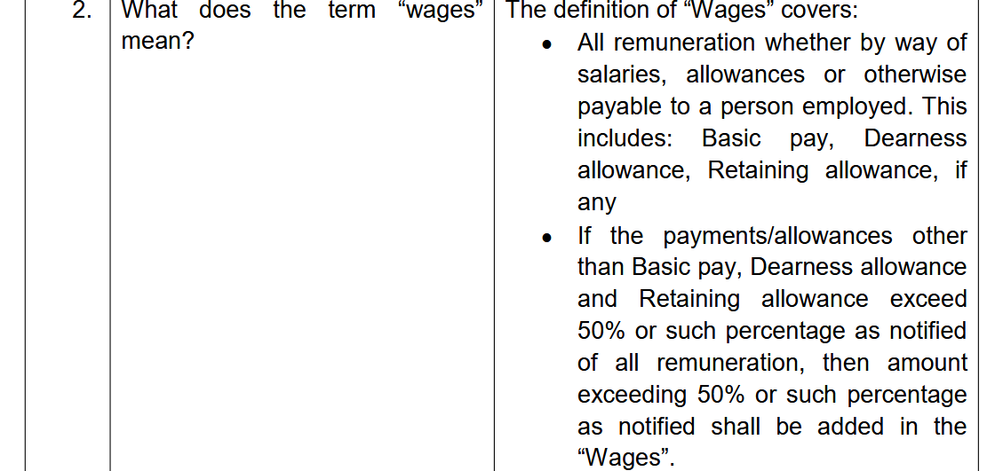
FAQ dated 30.12.2025

Slide 50
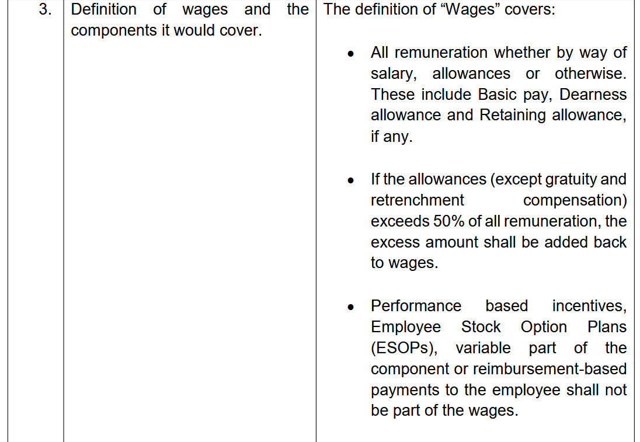
FAQ dated 30.12.2025

Slide 51
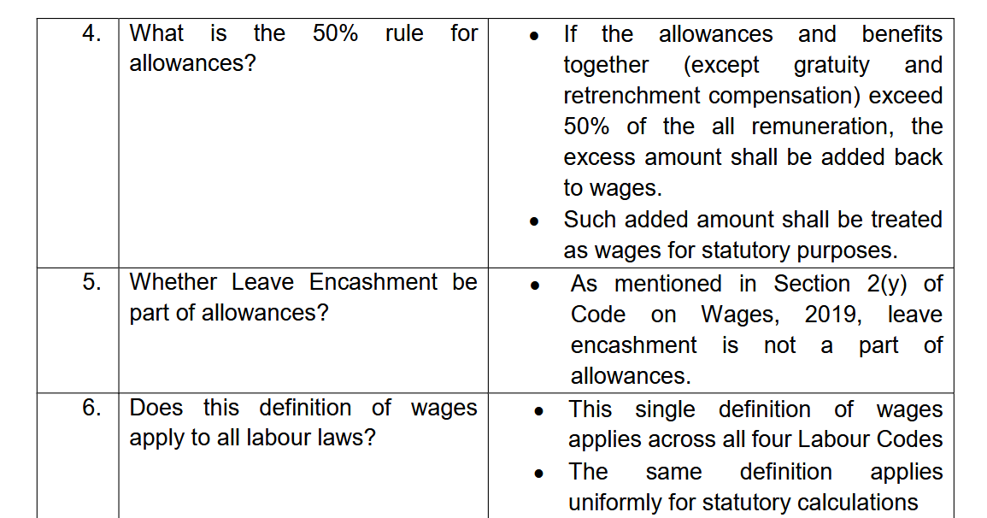
FAQ dated 30.12.2025

Slide 52
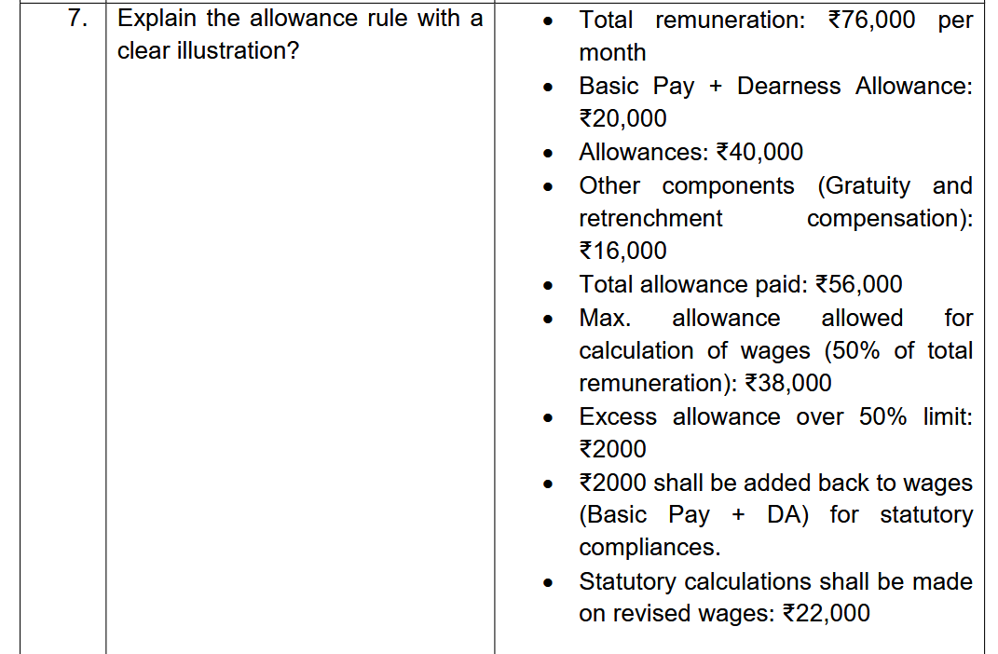
FAQ dated 30.12.2025

Slide 53
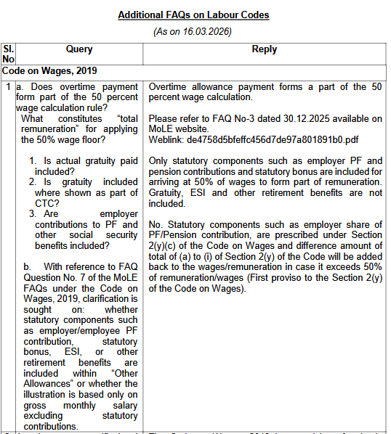

Slide 54
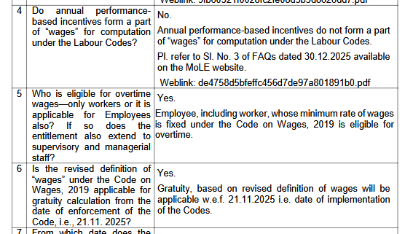

Slide 55
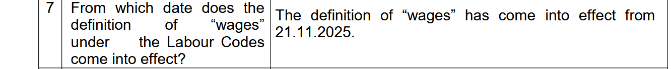
FAQ dated 16.03.2026

Slide 56
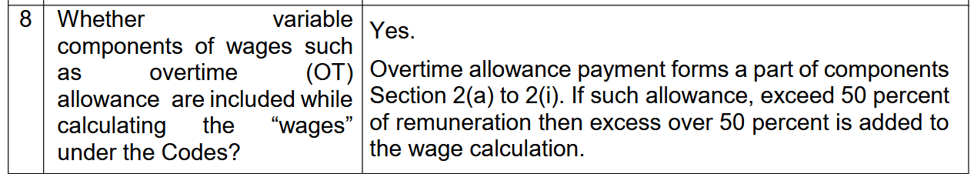
FAQ dated 16.03.2026

Slide 57
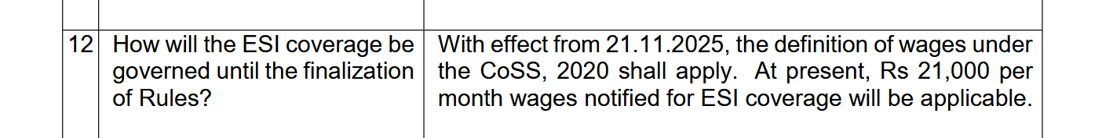
FAQ dated 16.03.2026

Slide 58
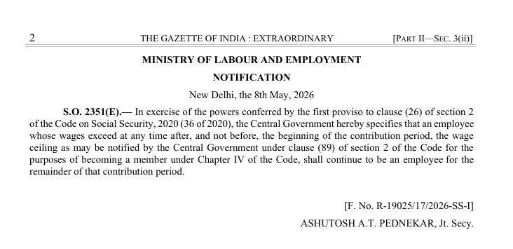

Slide 59
Thankyou.

